Slide 1

Input Cell
Output Cell
Back fed Input Cell
Match Input Output Cell
A Noisy Input Cell
Recurrent Cell
Hidden Cell
Memory Cell
Probabilistic Hidden Cell
Gated Memory Cell
A Spiking Hidden Cell
Kernel
Capsule Cell
Convolution or Pool

Slide 2



intro
Take a movement to apricate how crazy is it that brains can do it

Slide 3
Idea
Take a movement to apricate how crazy is it that brains can do it
All three are same even though all pixels are different

Slide 4
Statistical Learning and Support Vector Machines
Recent Developments (2010s-present)
Symbolic AI and Expert Systems
1957
1960s-1980s
1980s-1990s
1990s-2000s
2000-2010
2010s-present
perceptron
Connectionism and Neural Networks
Big Data and Deep Learning

Slide 5
What is deep learning ?
Teach computers how to learn a task directly from raw data

Slide 6
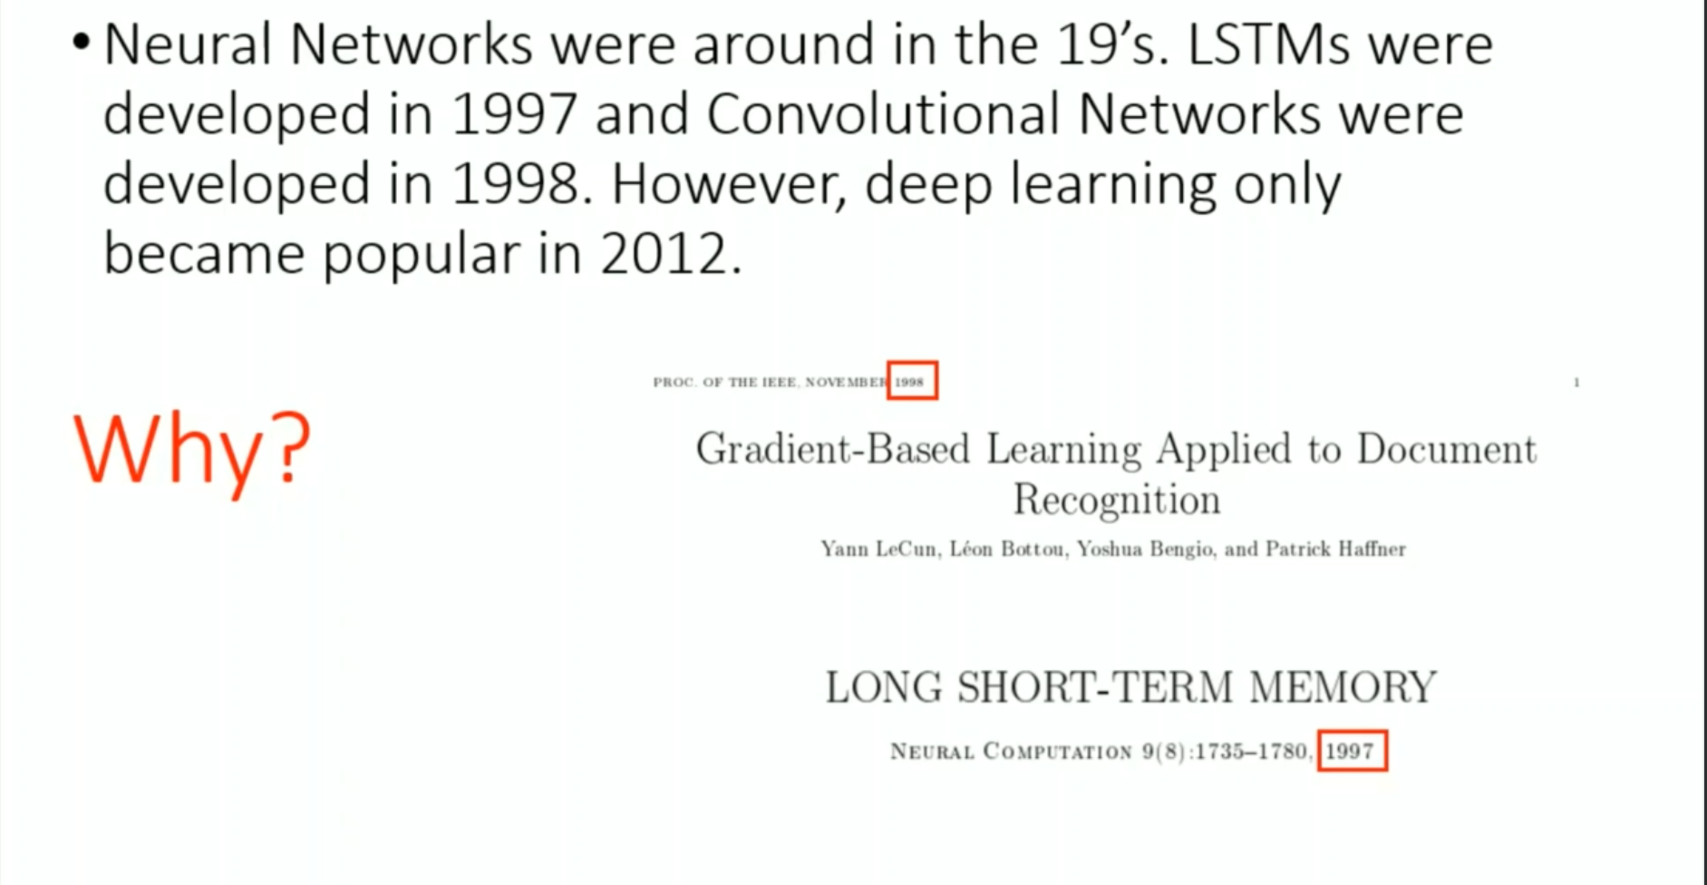
What is deep learning ?
Teach computers how to learn a task directly from raw data

Slide 7
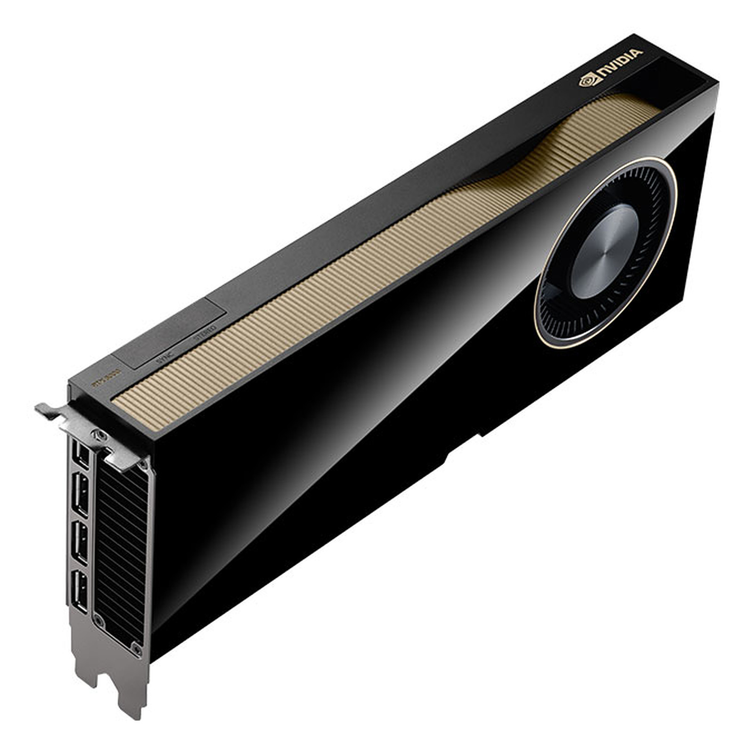
Why now?
Neural Networks date backs decades , so why now the dominance
1. Big Data
Larger Datasets
Easier Collection & Storage
2. Hardware
Graphics Processing Units
Massively Parallelizable
3. Software
Improved Techniques
New Models
Toolboxes
Notes:
https://www.image-net.org/

Slide 8
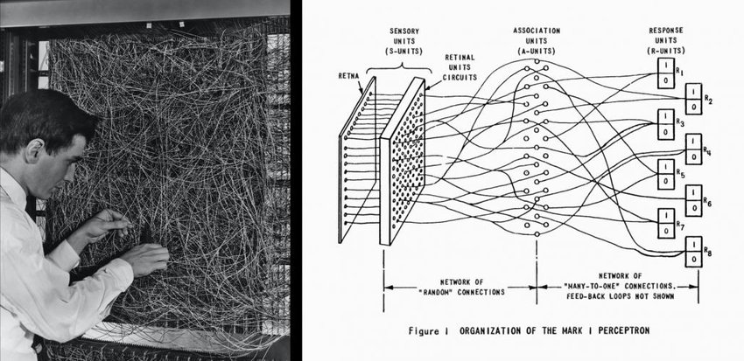
Alan Turing with perceptron
Notes:
https://www.youtube.com/watch?v=cNxadbrN_aI&t=66s

Slide 9
Single perceptron

Slide 10
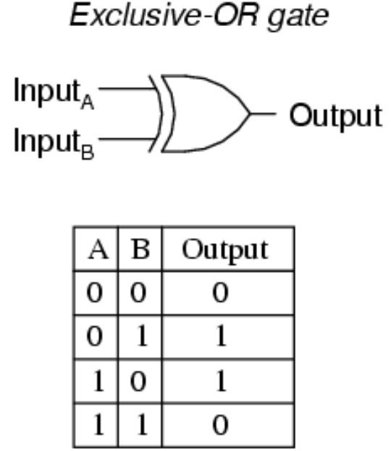
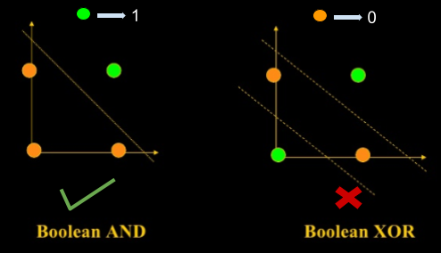
Solving XOR with a Neural Net

Slide 11
Multi layered perceptron

Slide 12
Representational Power of NN’s
NN with 1 hidden layer can represent :
Universal approximation theorem [Cybenko 1989]
- any bounded continuous function (to arbitrary ε)
- any Boolean function(exactly)

Slide 13
Current application of deep learning

Slide 14
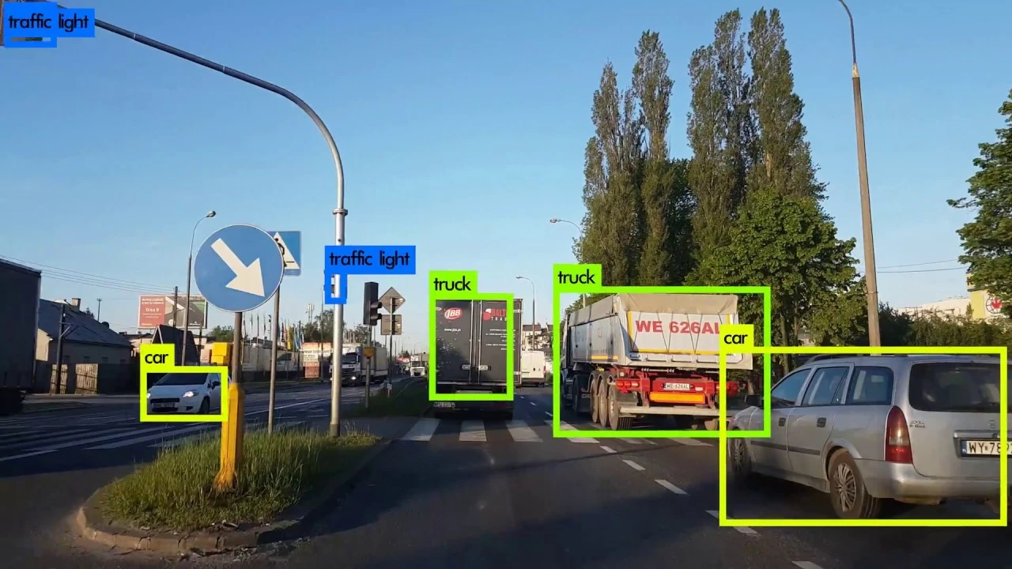
Object detection
Notes:
https://www.superannotate.com/blog/object-detection-with-deep-learning
Localizing and classifying a image
Bounding box

Slide 15

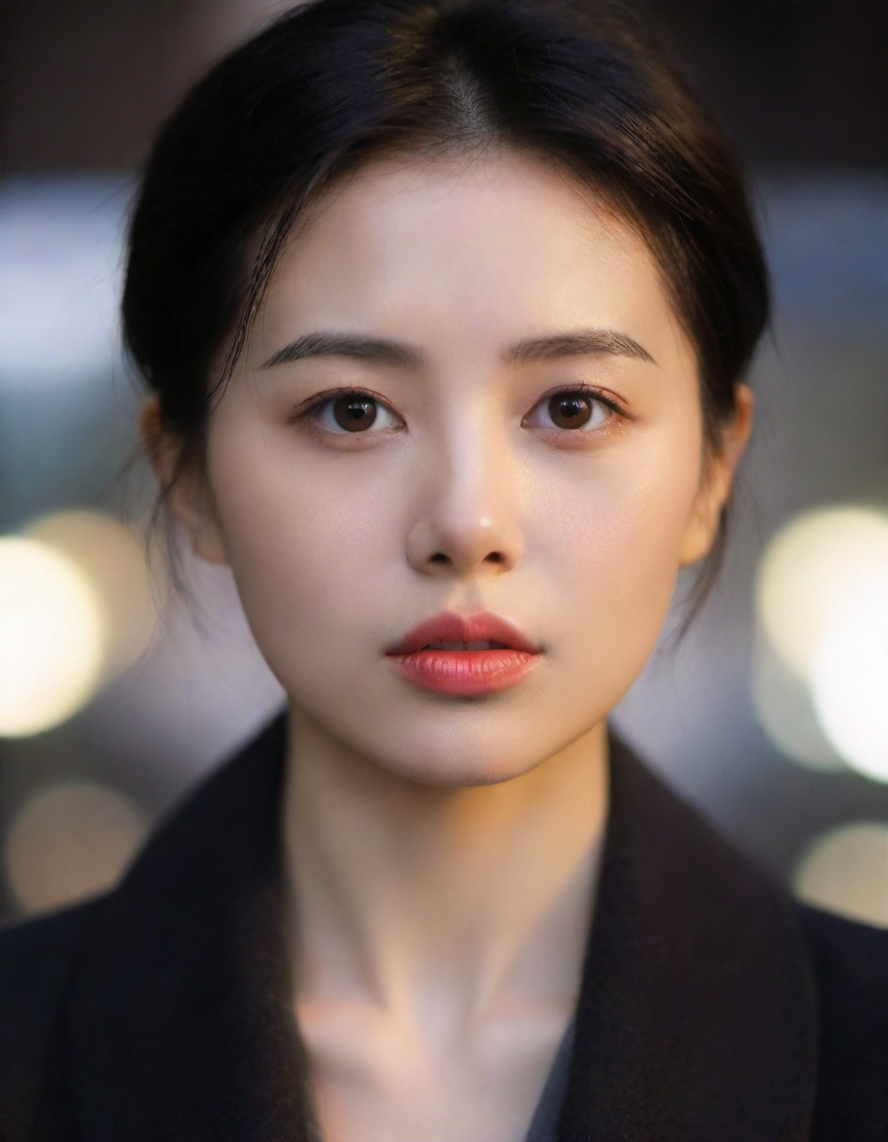
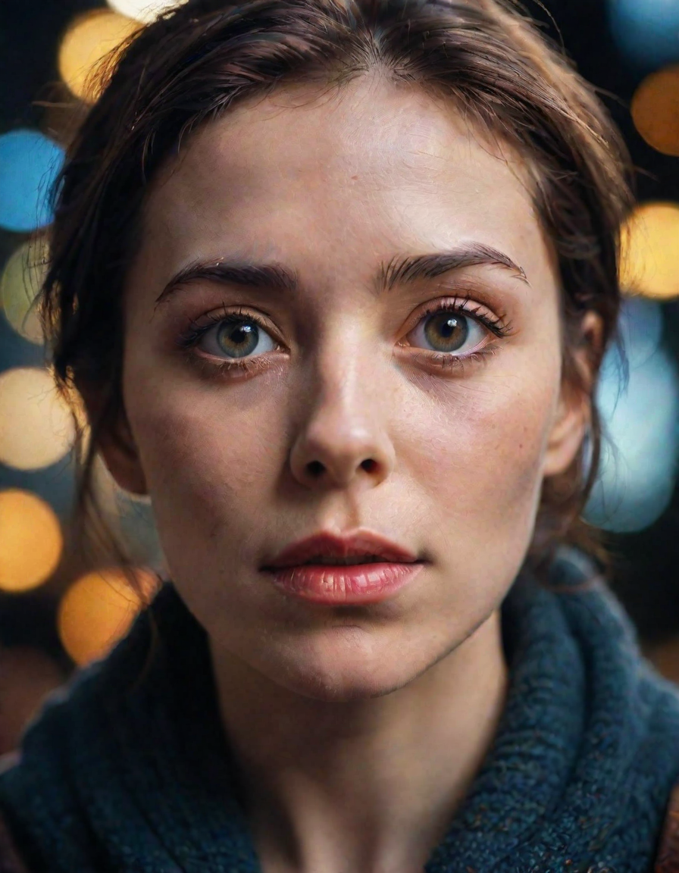
Generating faces
Notes:
Gan ; generative artifictial network
Normal distribution

Slide 16
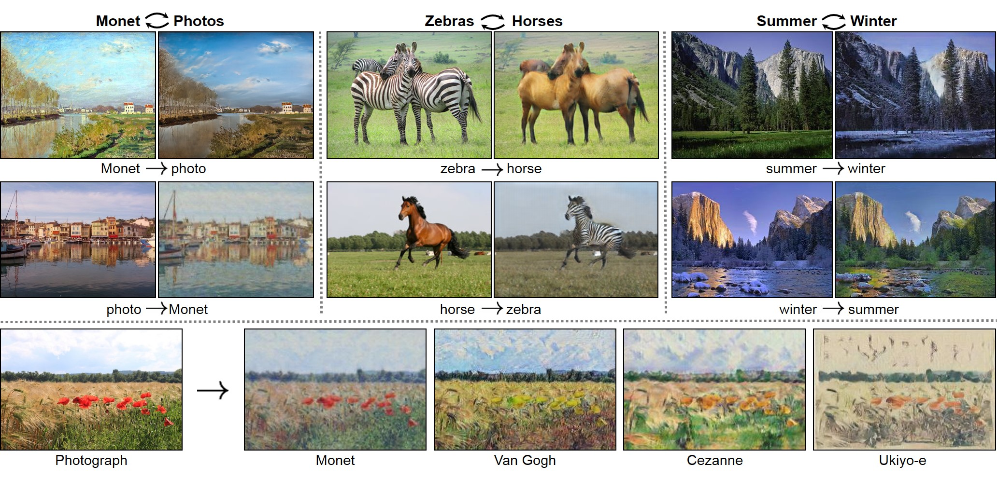
Cycle GAN
Notes:
https://junyanz.github.io/CycleGAN/
Unpaired image translation

Slide 17
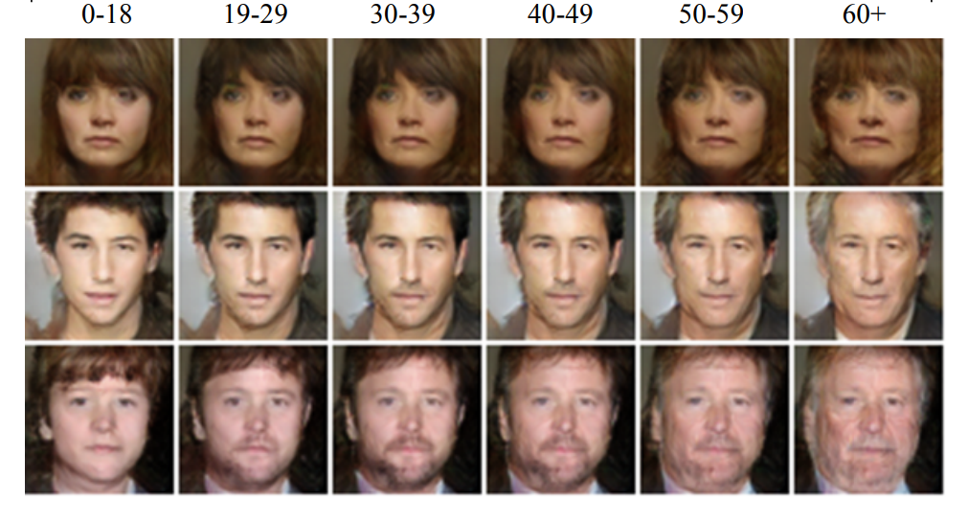
Face aging
Notes:
https://junyanz.github.io/CycleGAN/
Unpaired image translation

Slide 18
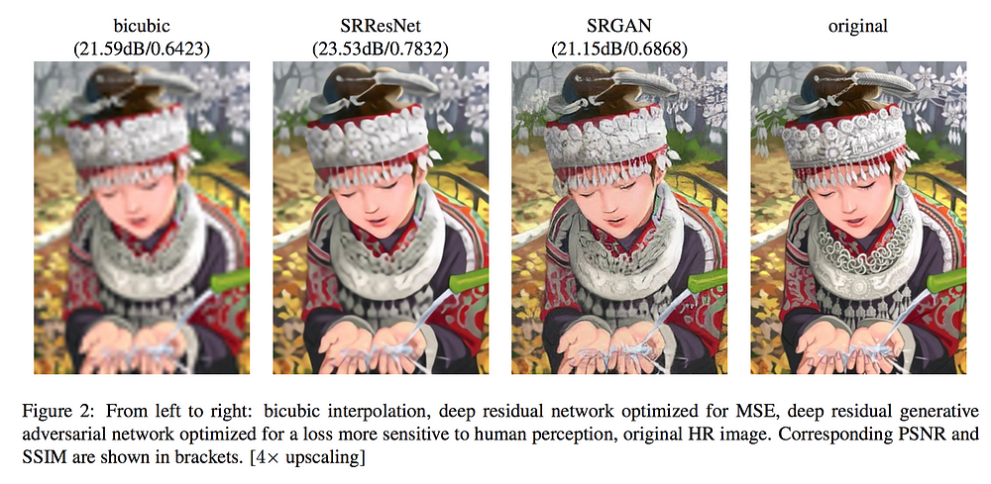
Super resolution
Notes:
https://junyanz.github.io/CycleGAN/
https://www.tensorflow.org/tutorials/generative/cyclegan
Unpaired image translation

Slide 19
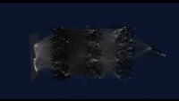

Slide 20
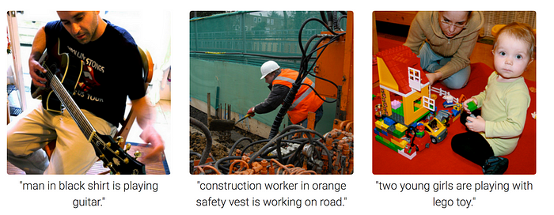
Image Captioning
Notes:
NLP

Slide 21
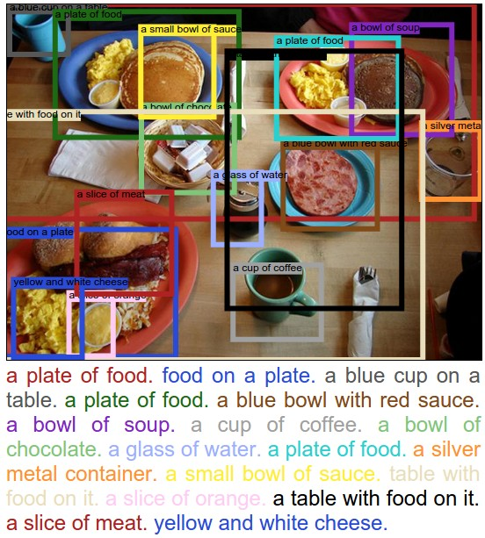
Image Captioning
Notes:
NLP

Slide 22
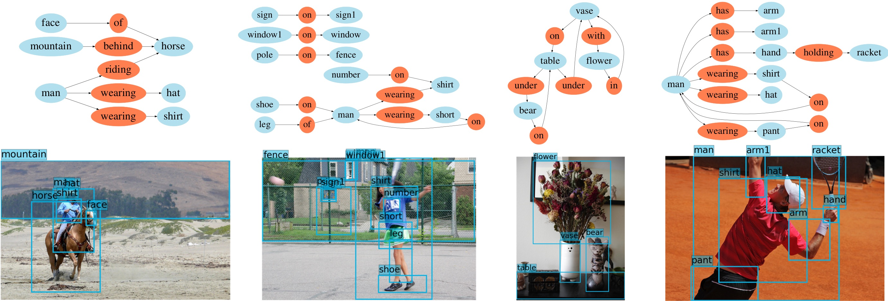
Scene Graph generation:
Notes:
Objects and relation ship in a image

Slide 23
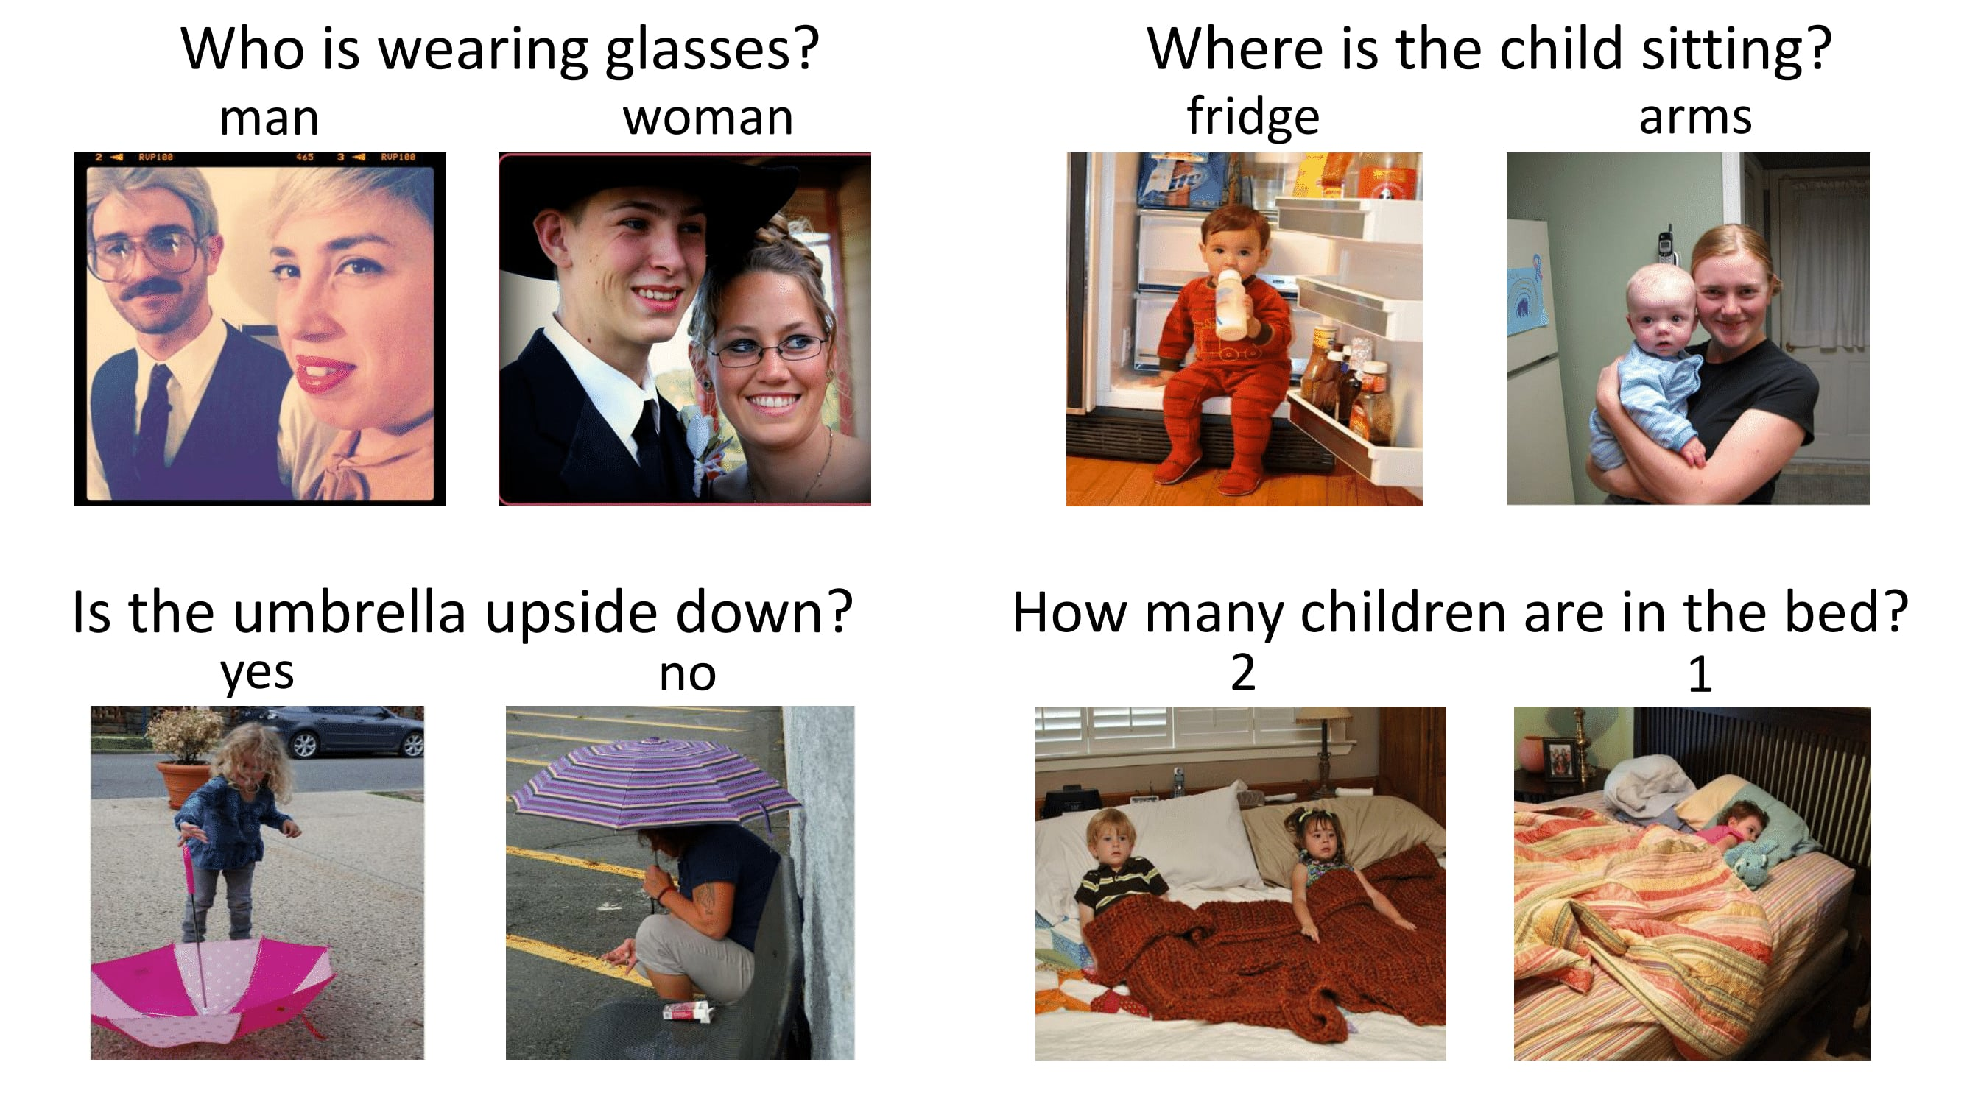
Visual question Answering
Notes:
Objects and relation ship in a image

Slide 24
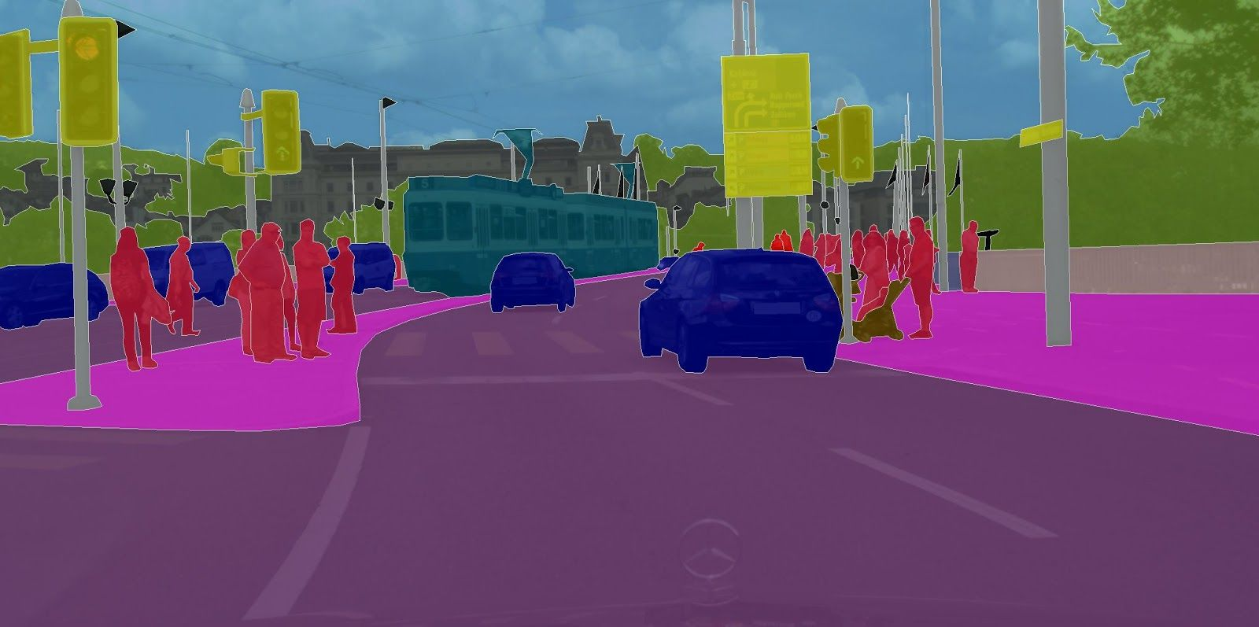
Semantic segmentation
Notes:
Segment out objects in a image
Replace other objects

Slide 25
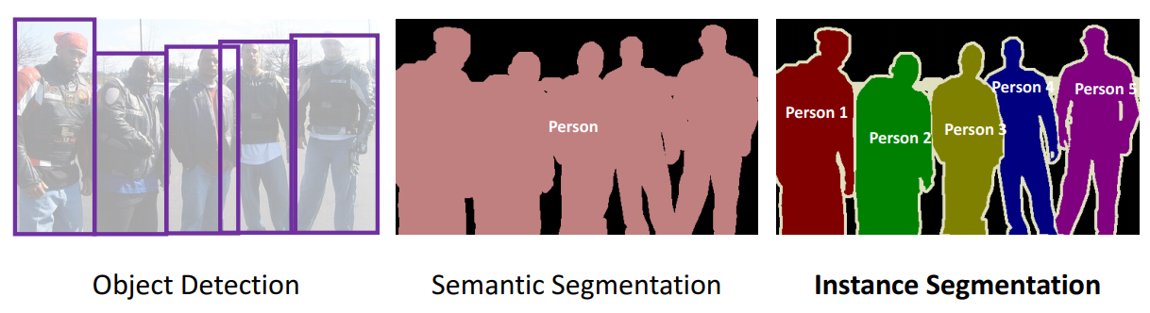
Instance segmentation
Notes:
Mask RNN

Slide 26
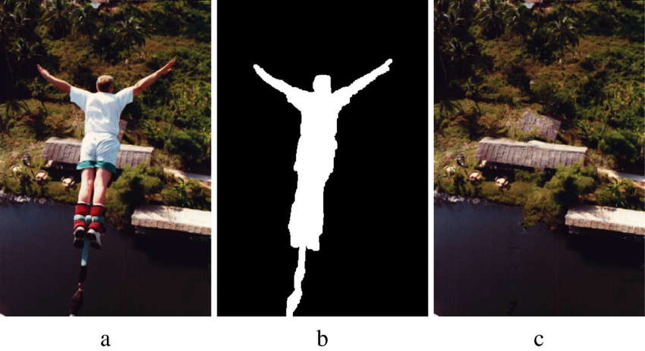
Image inpainting
Notes:
Mask RNN

Slide 27
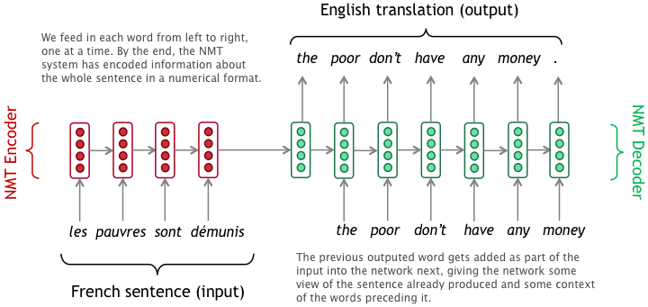
Seq2Seq Machine Translation
Notes:
Mask RNN

Slide 28
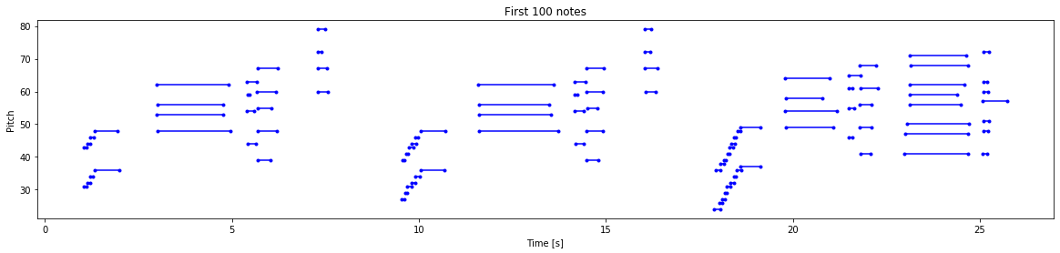
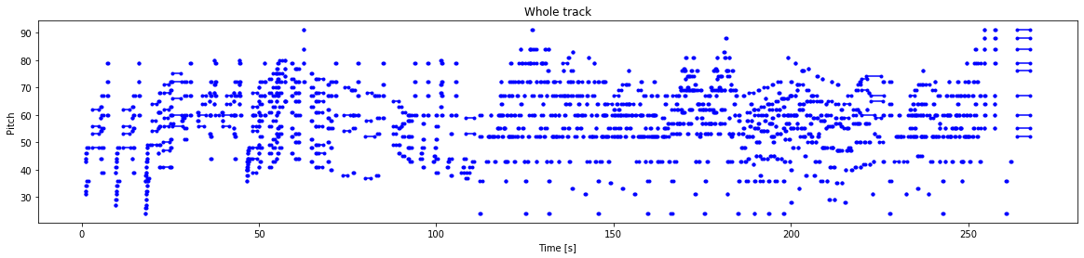
Music Generation
Notes:
Mask RNN

Slide 29
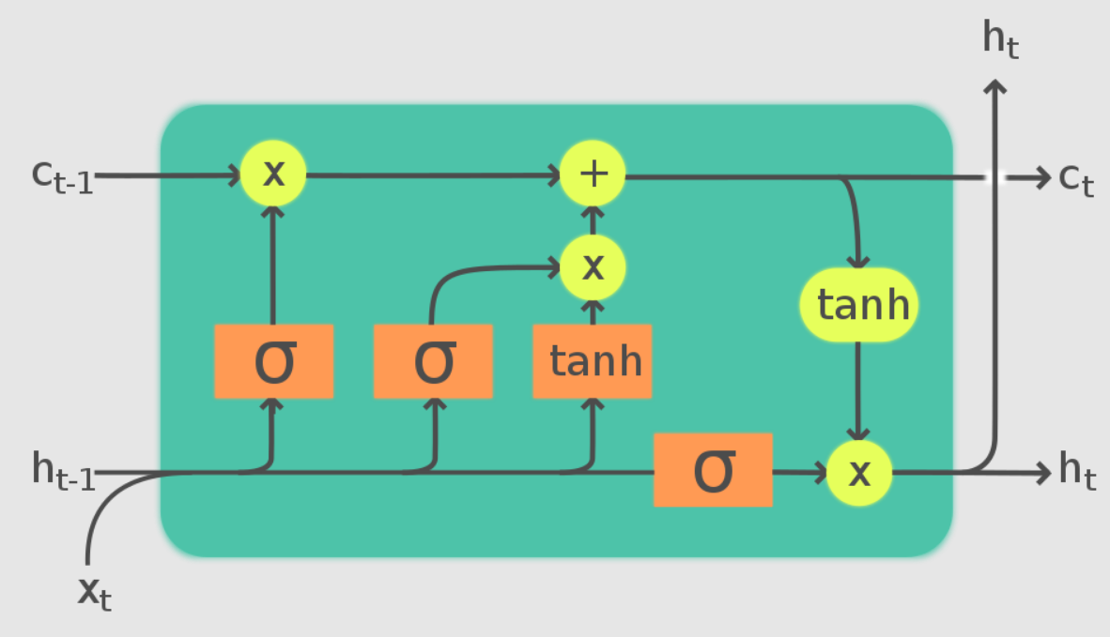
LSTM
Notes:
LSTM
https://blog.paperspace.com/music-generation-with-lstms/

Slide 30
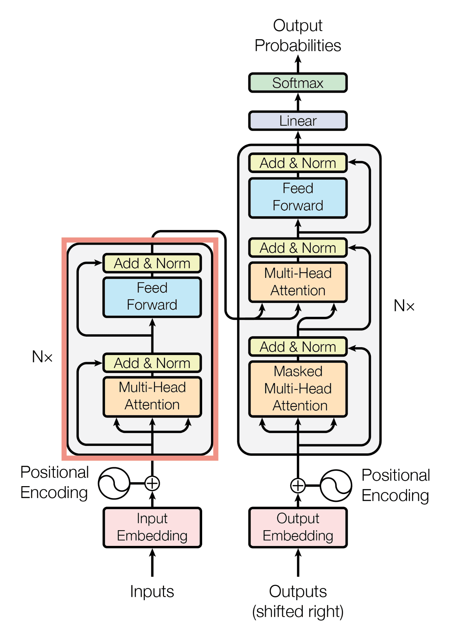
Transformers Architecture
Notes:
LSTM
https://blog.paperspace.com/music-generation-with-lstms/

